Slide 1
A2H 3D case THERMAL status

Slide 2
Thermal test precondition
1. Disable 3D BL thermal policy
2. Enable CPU & GPU thermal policy
3. Running 60 minutes

Slide 3
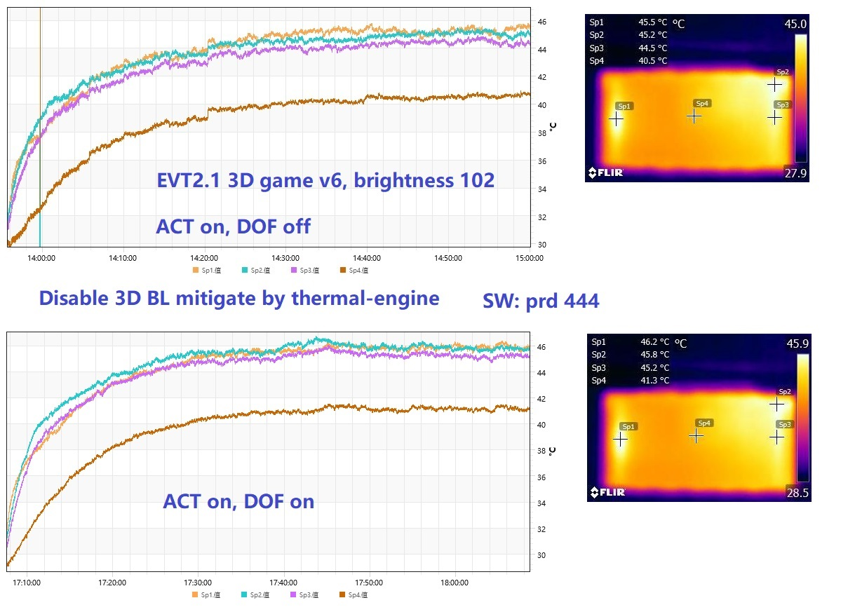
3D game, default 3D BL 102

Slide 4
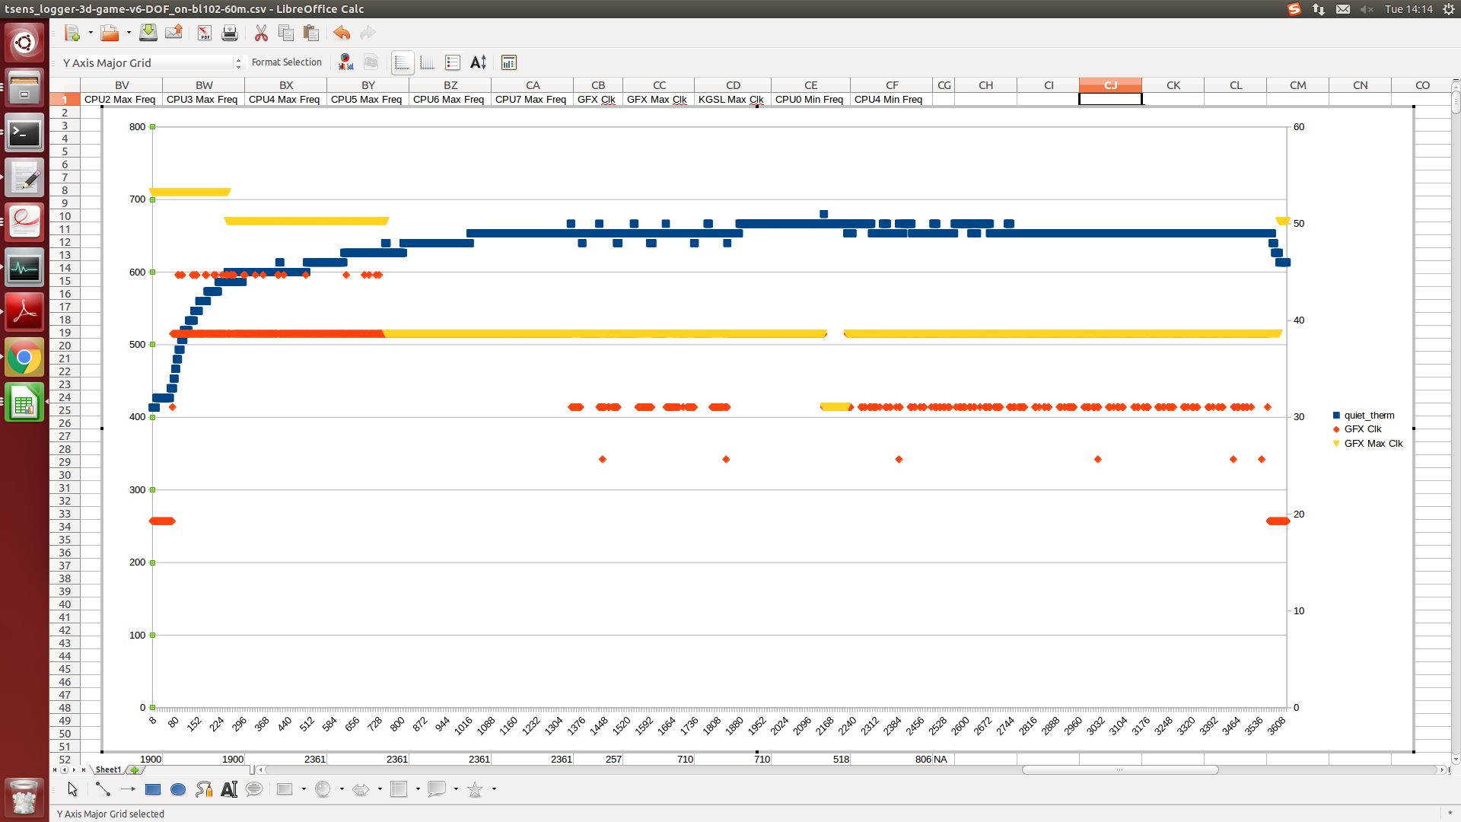
3D game, ACT on, DOF on

Slide 5
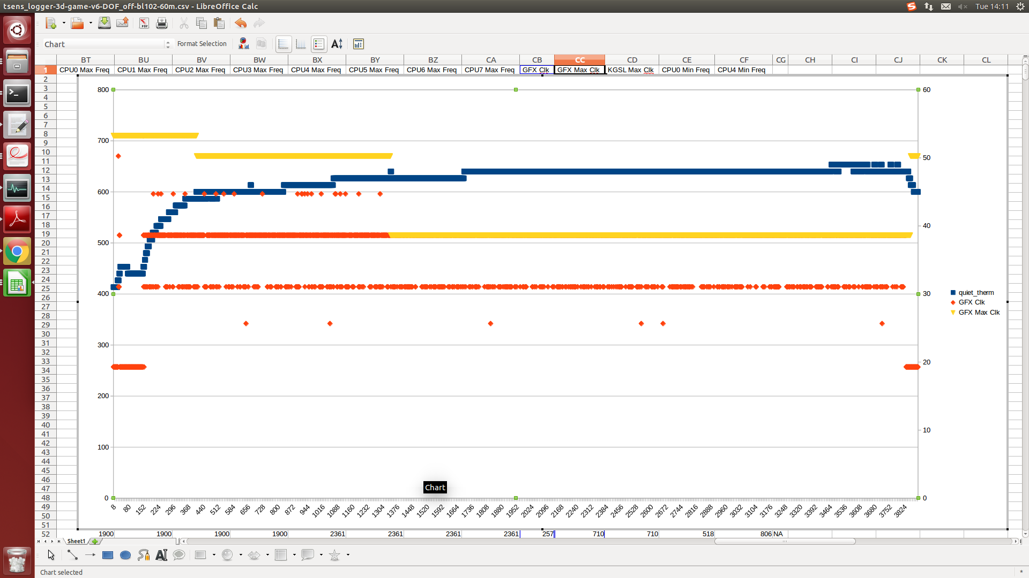
3D game, ACT on, DOF off

Slide 6
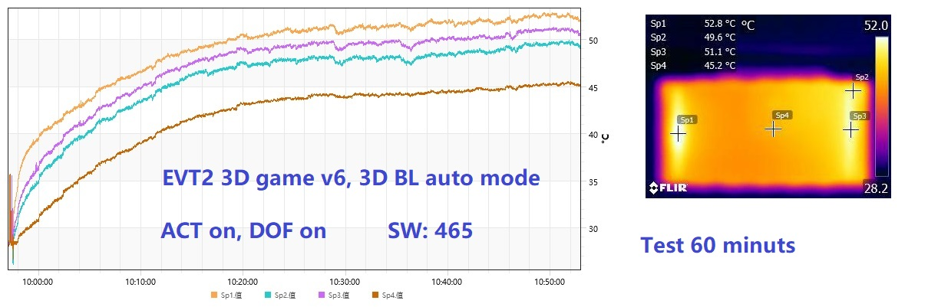
3D game, 3D BL max 255

Slide 7
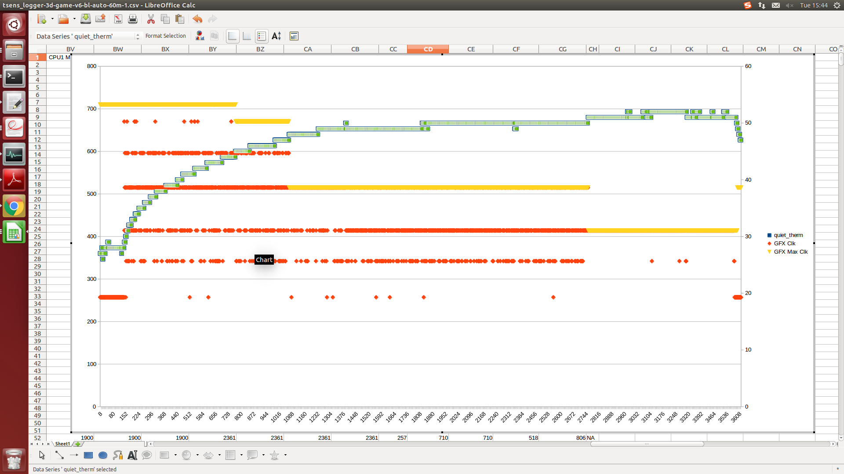
3D game, default BL 102

Slide 8
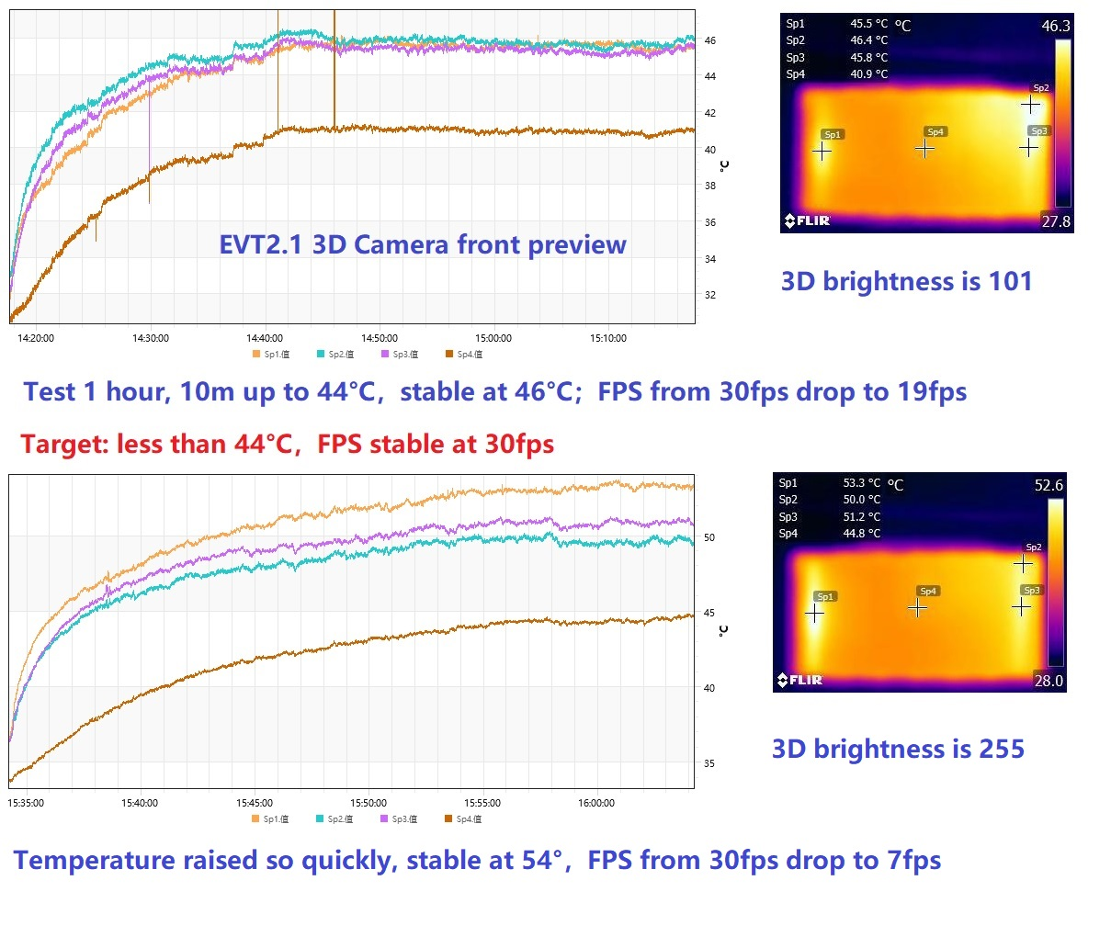
3D camera, default & max BL

Slide 9
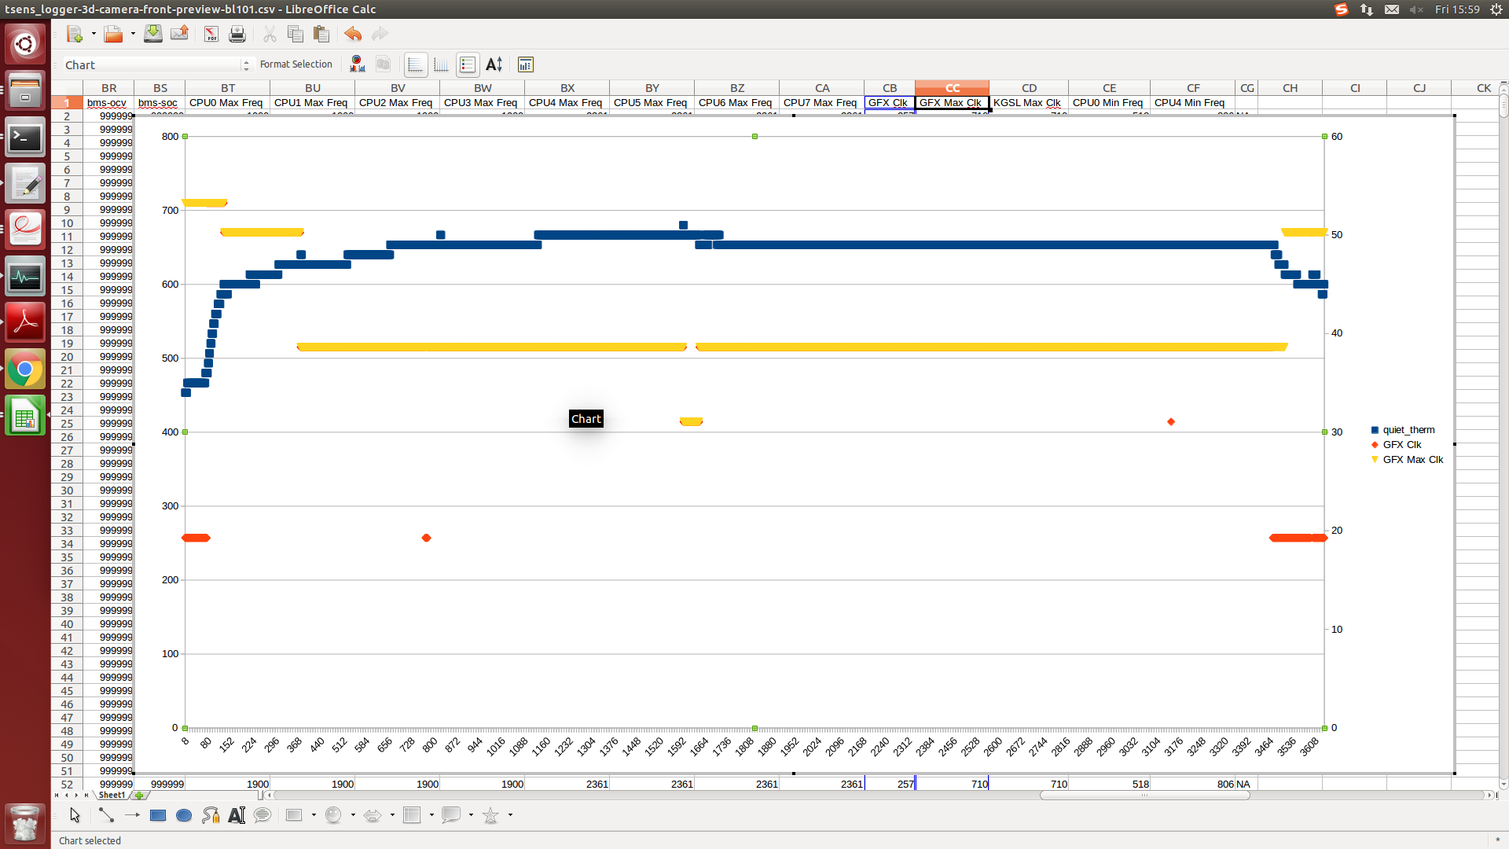
3D camera, default BL 102 GPU mitigating

Slide 10
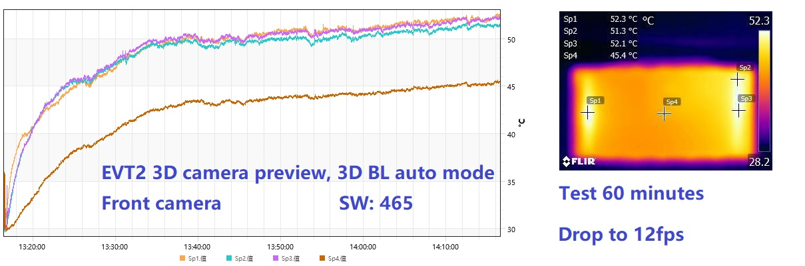
3D camera,3D BL max 255

Slide 11
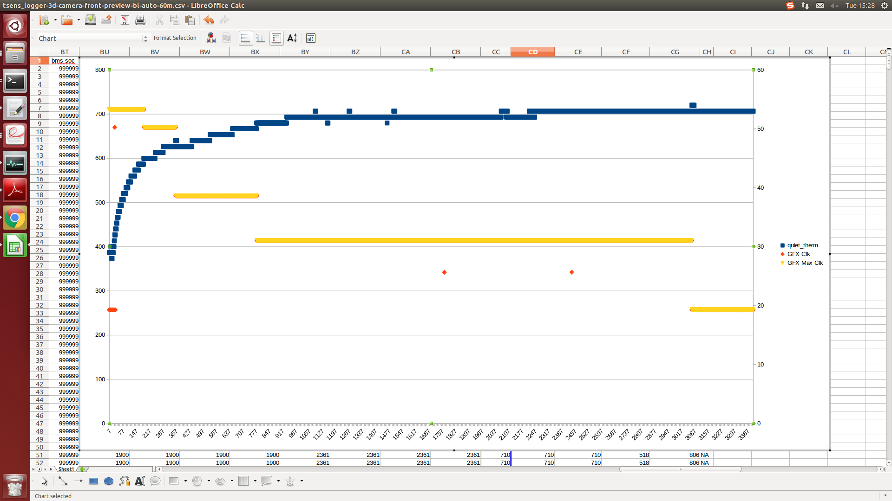
3D camera,3D BL max 255 GPU mitigating

Slide 12
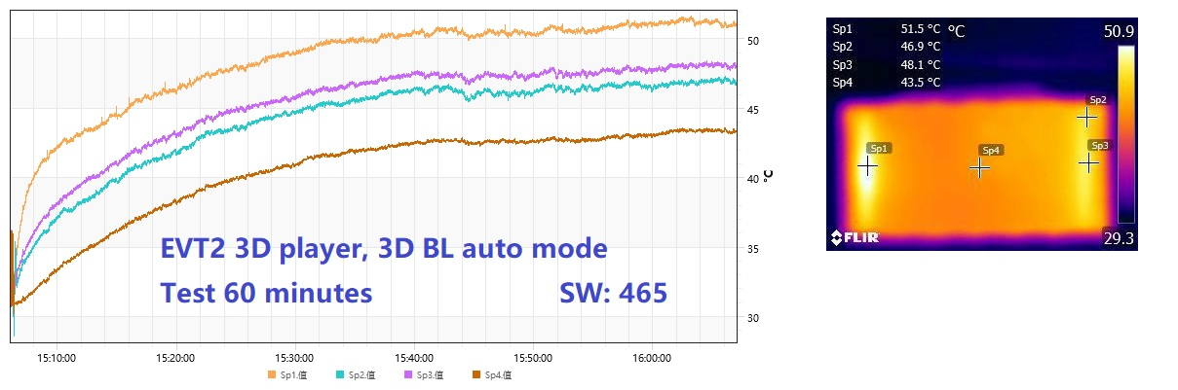
3D player,3D BL max 255

Slide 13
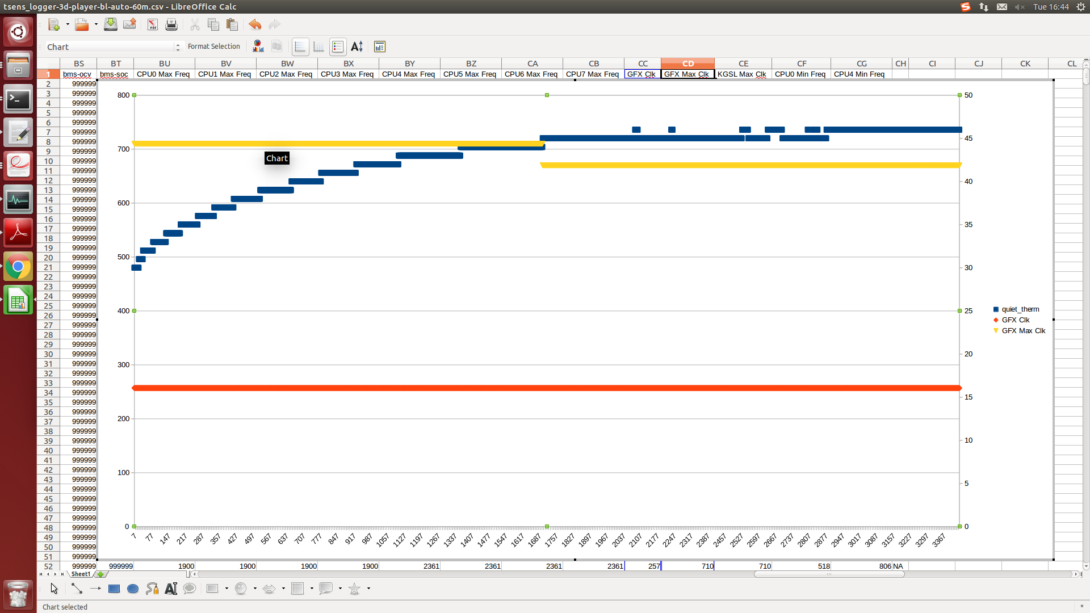
3D player, 3D BL max 255 GPU mitigating

